Slide 1

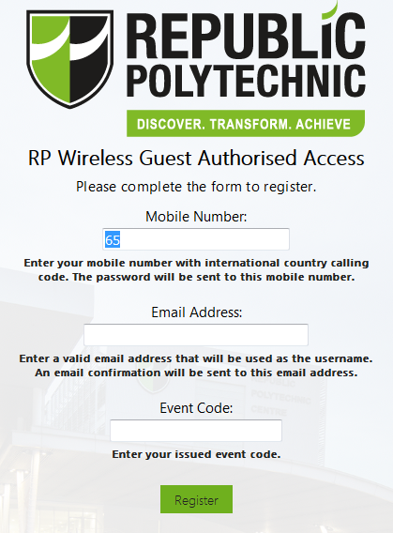
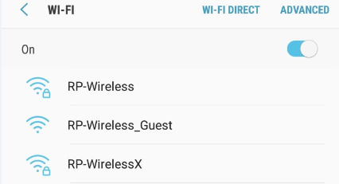
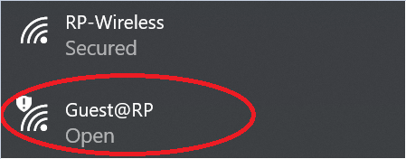
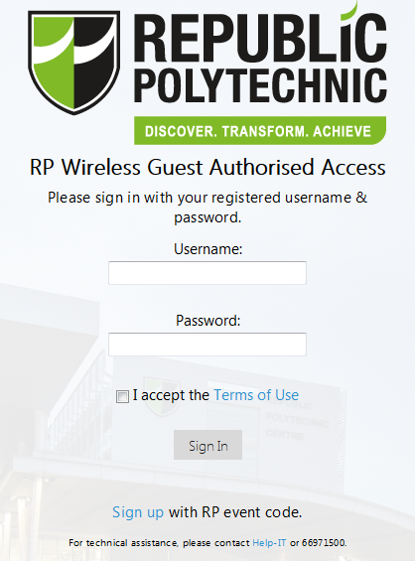
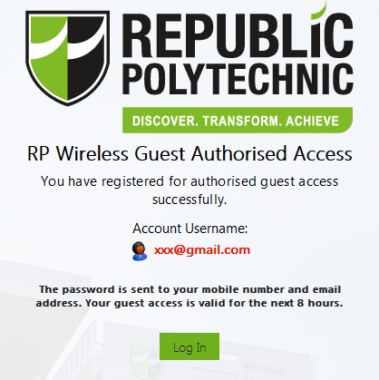
Step-by-step guide for Guest WiFi Access
4. Enter your mobile number, email address, and event code to register.
Event code: EV-7441WB
1. Connect your smartphone/tablet or laptop PC to “RP-Wireless_Guest OR Guest@RP”
1
2
3
EV-3809JY
2. Launch any browser (e.g. IE, Chrome, Safari, Firefox, etc.).
You will be redirected to the RP Wireless Guest Authorised Access Portal.
5. The password for the wireless guess account will be sent to the mobile number and email address used for registration in Step 4.
Click on “Log in” and proceed to sign in as an authorised guest with the issued password.
3. Click on the “Sign up” link to register for a wireless guess account.

